Slide 1
Emotion Analyis (feat. R)
- Flight company -

Slide 2
Overview
Asiana air vs Korean air by Title
Asiana air vs Korean air by Main Text
Emotion Analysis by Using Directory
Result Analysis
Method Comparison

Slide 3
Contents
Crawling Process by using Rvest
Creating each Tables
Data Preparation Step
Data Visualization
Plot Analysis
Draw an meaningful Analysis Conclusion

Slide 4

Web Crawling

Slide 5
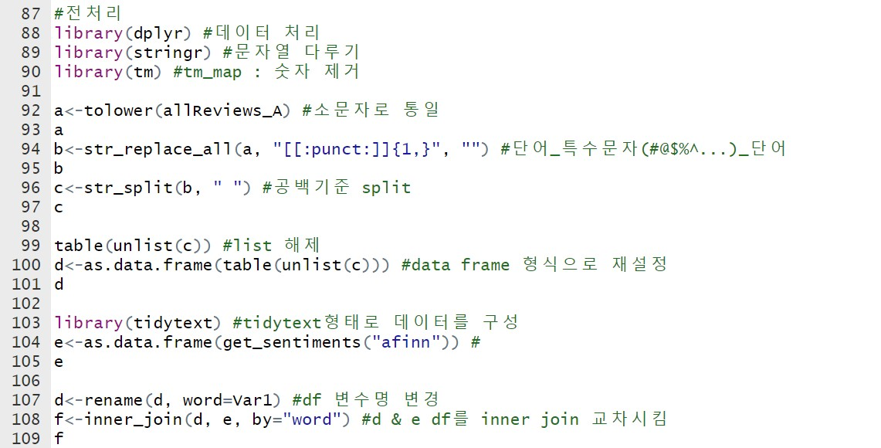
Data Preparation

Slide 6
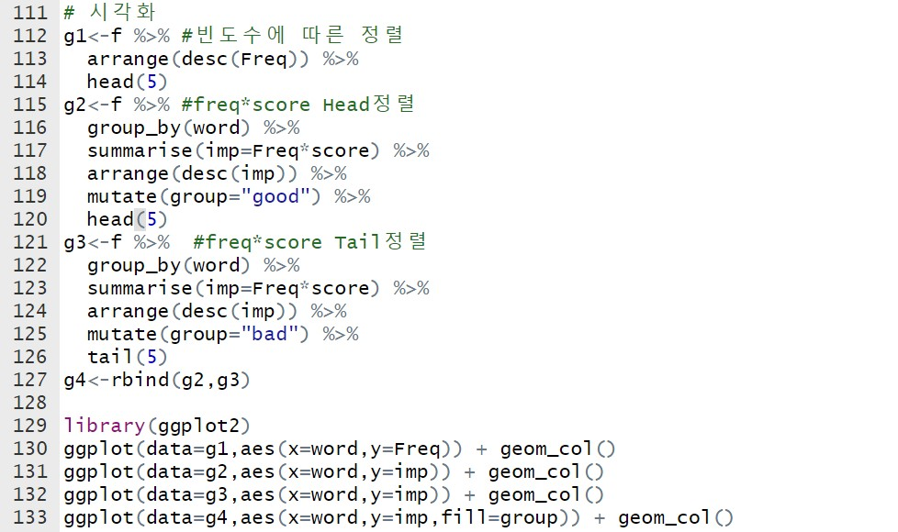
Data Visualization

Slide 7
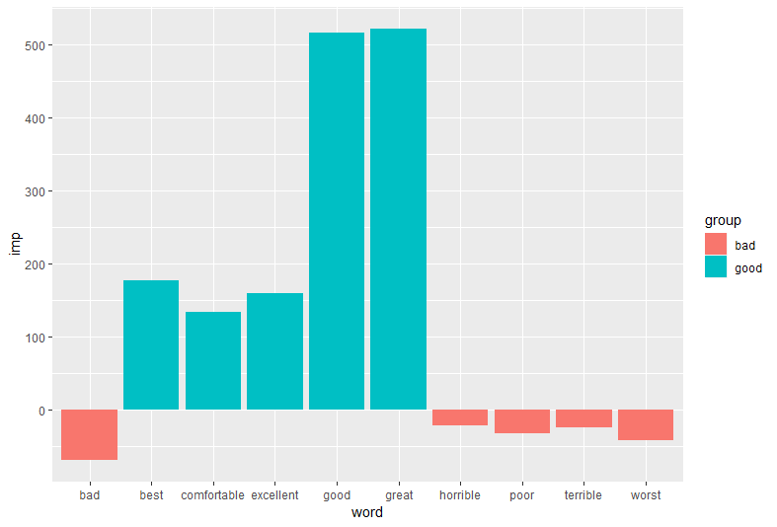
Plot Analysis – aT

Slide 8
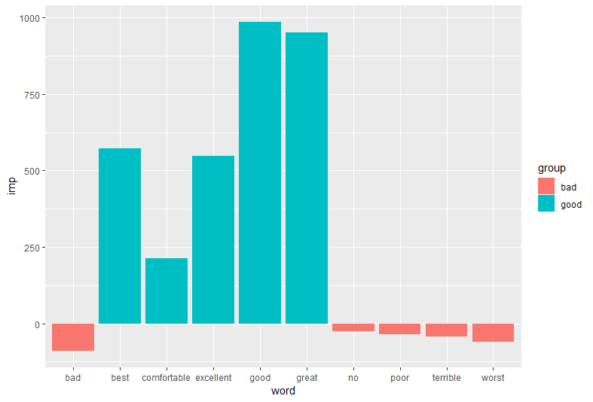
Plot Analysis – kT

Slide 9
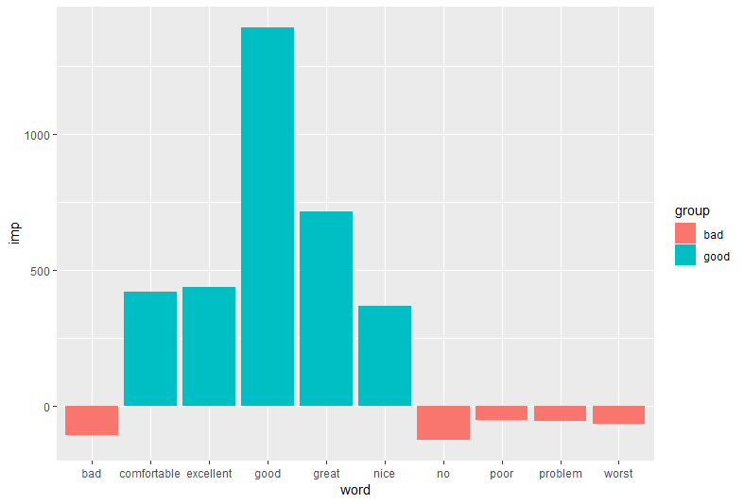
Plot Analysis – aM

Slide 10
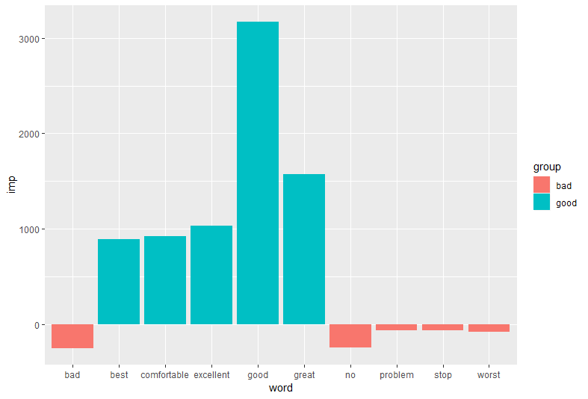
Plot Analysis – kM

Slide 11
Analysis Conclusion

Slide 12
url_default_K_1<-“url 주소"
for(page in seq(from = 1,to=2610,by=5))

